Slide 1
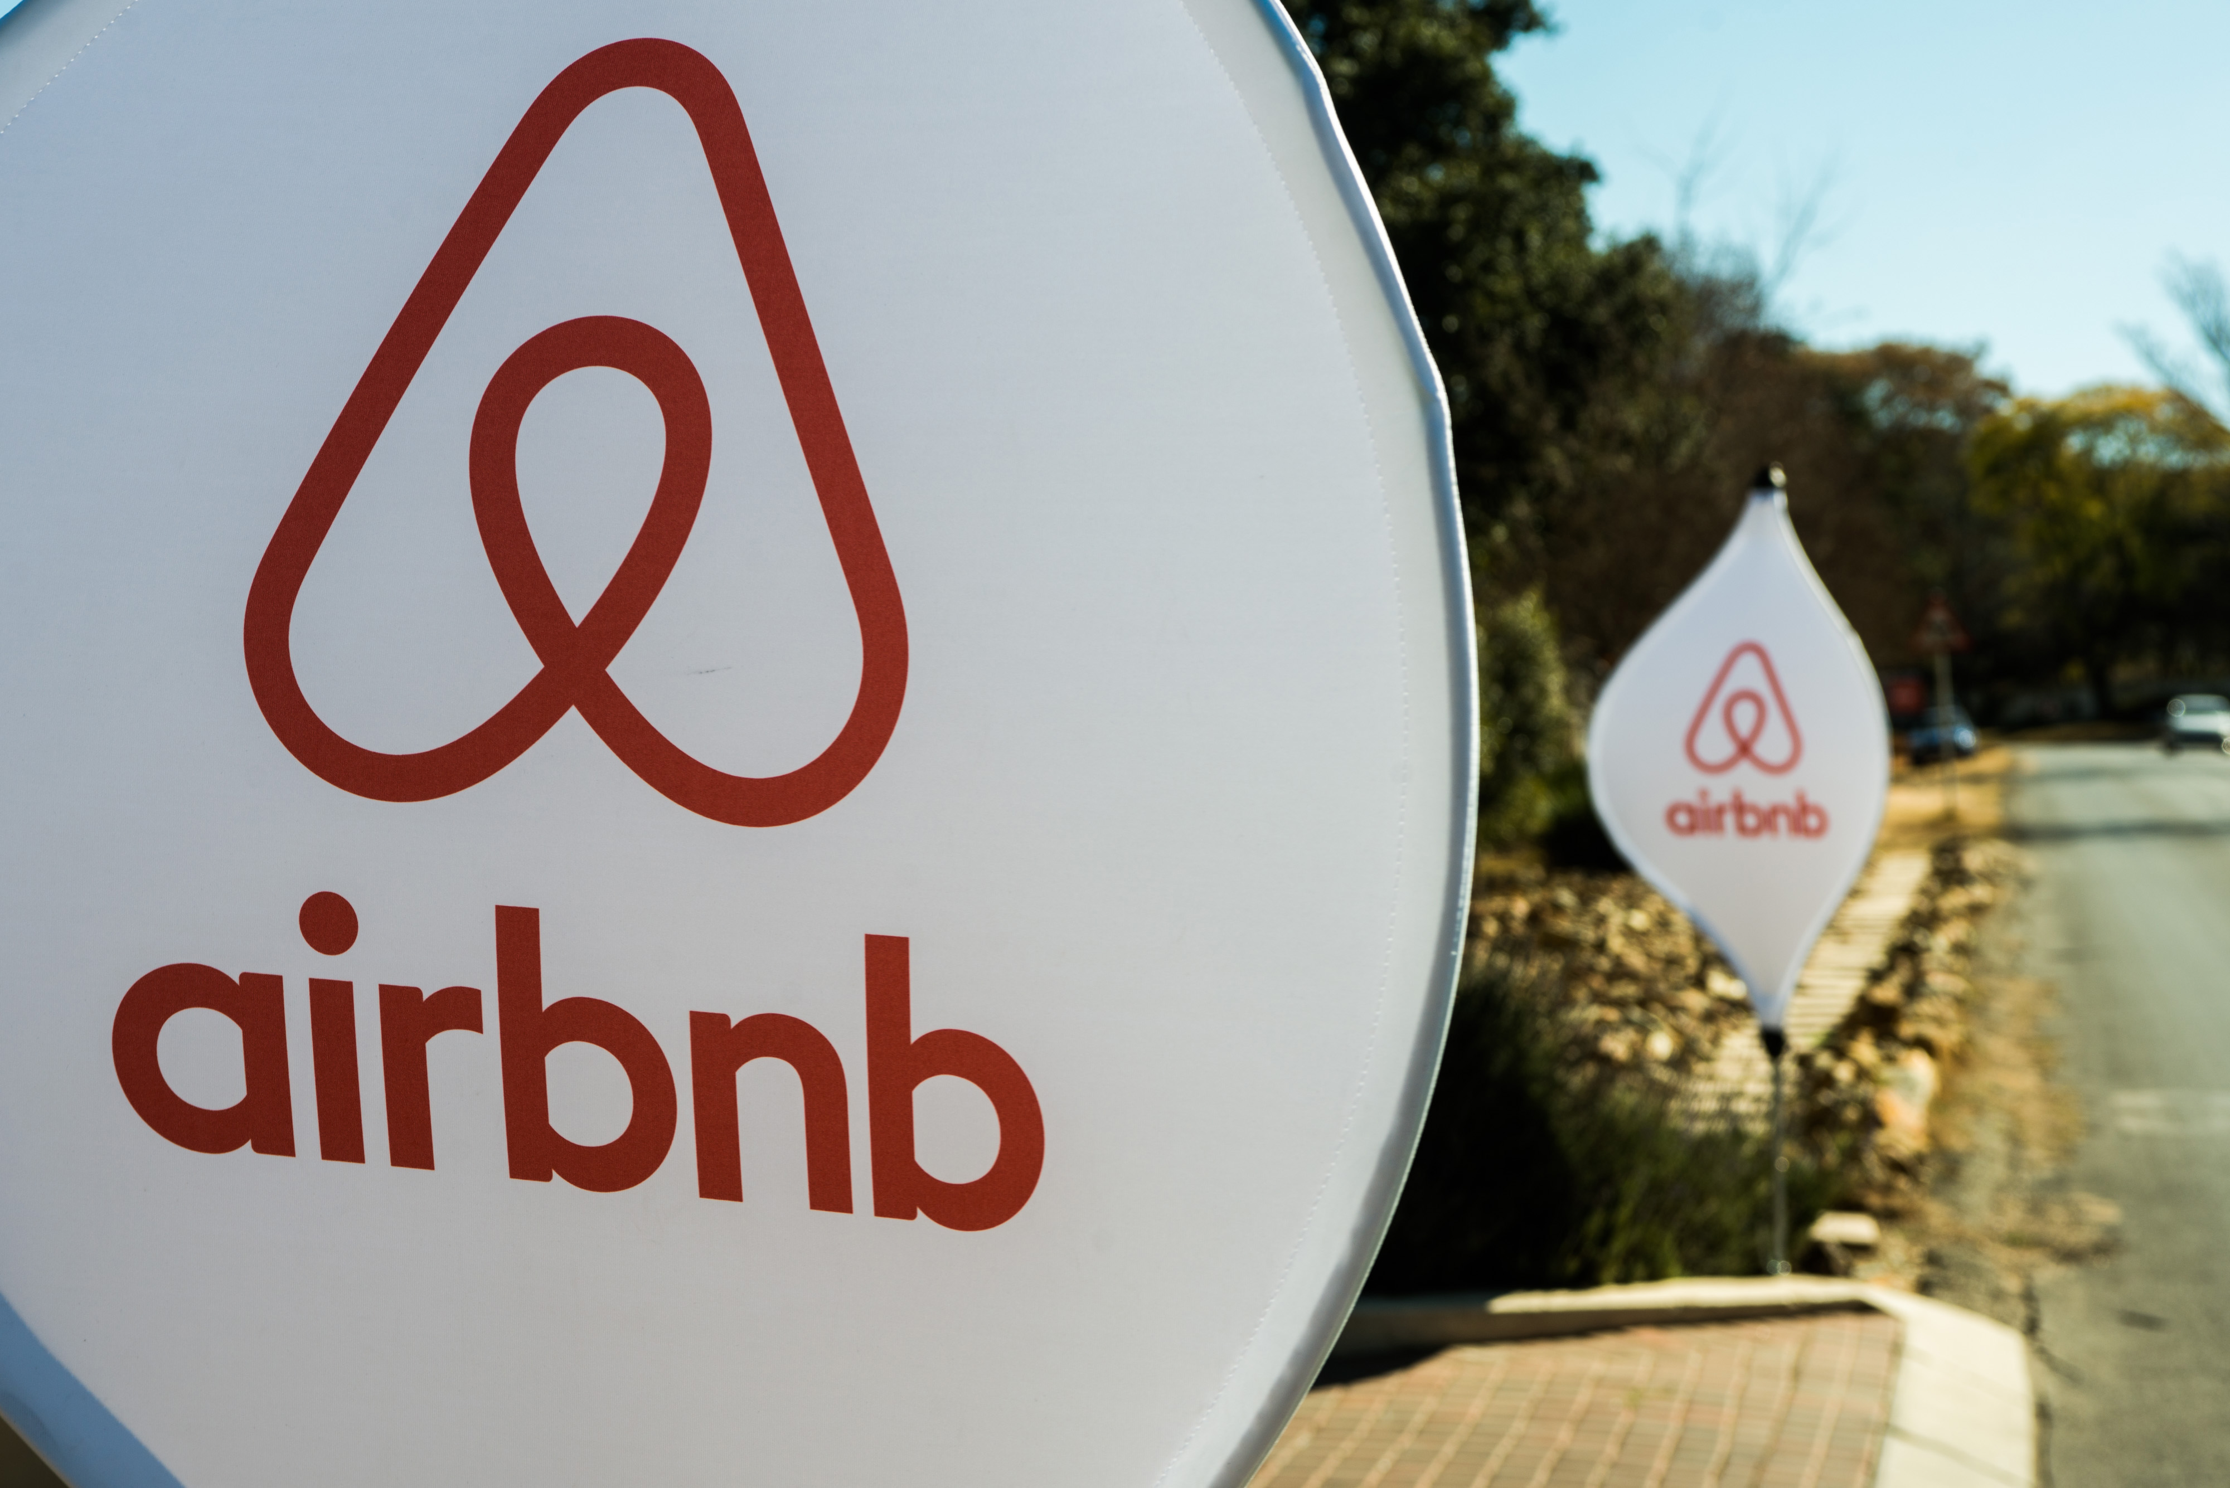
Text Mining Presentation
“Lets go on a trip”
IS450 Team: G1T1
Ahmad Saifullah Bin Mustaffa|Gan Min Xuan Darren| Lu Yun Jing Ada
Muskaan Gupta| Shubham Periwal| Vikram Sanghi

Slide 2
Content
Company Introduction, Situation Overview
Solutions
Text Analytics Tasks and rational
(Sentiment – classifier vs lexicon based)
Insights and Analysis
Challenges
Future work
Team Learning Points and contribution

Slide 3



Company Introduction
About Company
Airbnb connects travellers to available houses
Notes:
https://www.airbnb.com.sg/s/Los-Angeles--CA--United-States/all?refinement_paths%5B%5D=%2Ffor_you&query=Los%20Angeles%2C%20CA%2C%20United%20States&place_id=ChIJE9on3F3HwoAR9AhGJW_fL-I&search_type=AUTOCOMPLETE_CLICK

Slide 4





Problem Overview
Stakeholders
Traveller
House owner
A lot of time spent on reading through reviews
Unavailable filters (Eg: Cleanliness)
Less bookings
Slow and inefficient decision to choose the listing
Lack of insights to decide the structuring of listing

Slide 5
Solutions
Using Text Analytics

Slide 6
Solutions Initiatives & Rationale
1
2
3
4
Reviews Summary
Reviews Sentiments
Cluster Topic Analysis
Chat Bot to allow for additional filters
Summarized passage for every listing with 100+ reviews. Enables faster understanding of reviews
Facilitates decision making by quick grasp of overall sentiment and even to compare listings
Allows house owners to understand what is relevant and structure the listing accordingly to increase bookings
Removes dashboard limitations to filter based search by making way for personalized question answerings

Slide 7
Demo, Insights and Analysis

Slide 8
Insights and Analysis
1
2
3
4
Reviews Summary
Reviews Sentiments
Cluster Topic Analysis
Chat Bot
People who give positive reviews in LA prefer to interact with their host / prefer a personal touch
Majority of the reviews are positive towards host and negative ones tend to be directed towards facilities
The top keywords for each listing tend to be positive words. The clusters can be labelled as “location”, “host”, and “amenities”
Rating for locations has a high standard deviation showing people are affected by it

Slide 9
Text Analytics Tasks

Slide 10
Reviews Summary Text Analytics Tasks
Group reviews by listing id
Construct word frequencies from remaining words
Score individual sentences based on word frequencies
Form a summary using the top 3 scored sentences
Tokenize & remove stopwords from reviews in the group
Filter out non-English reviews
Notes:
Word Frequency is calculated using no. Of times word appears in corpus / no. Of times the most common word appears
Sentences are extracted using priority queue, with their score as the priority
Extractive summary

Slide 11
Why TF? Rational
TF
IDF
1) Common Terms
2) Long sentences
3) Relevance of high-weight sentences
More the better
Thus, we go ahead with TF over IDF
Notes:
Sentences that talk about the most-mentioned terms are more relevant
Long sentences are worth more than short sentences

Slide 12
Chat Bot Text Analytics Tasks
Intent Detection (Question/Greeting/Goodbye)
Information Retrieval (hotel/price/neighbourhood)
Document Retrieval (Query answer from dataset)
Answer Generation (Generate and send response)
If question, detect question type using regex
If not question, give pre-defined response

Slide 13


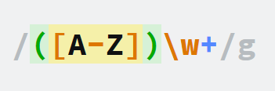
Chatbot Above and Beyond
Intent Detection
Bot
Regex
From the user input, detect whether user is greeting, asking a question, or saying goodbye
Implementing the bot on python to act as a platform for question answering
Used the research articles read for assignment 2
- re.compile​
Used to create different patterns of questions possible​
- re.sub​
Used for data cleaning
- Regex groups
Used to detect different entities entered by the user

Slide 14
Topic Cluster Analysis Text Analytics Tasks
extract all reviews for this particular listing from the dataset
Conduct cluster analysis using LDA
Conduct lemmatization, create dictionary & corpus
remove stopwords, identify bigrams and trigrams in the reviews
(and tune the parameter to classify into 5 clusters)

Slide 15
Reviews Sentiments Text Analytics Tasks
Remove Stop words and stemming
Create a labelled training data
Train the classifier
Add label(polarity) to each review

Slide 16
Why Supervised? Rational
Supervised
Lexicon
1) Flexibility
2) Accuracy
3) Training
More the better
Supervised was more suitable to our problem statement

Slide 17
Future Work

Slide 18
Work and Rationale
Area | Future Work
Analytical | Adding training dataset to attach labels to our clusters because right now we are only able to interpret the words under each cluster to define our own labels.
 | Making the summary extractive vs abstractive; Detecting
Technical | Making the dashboard live and query based
 | Making the Bot generative instead of having rule based method

Slide 19
RISKS & MITIGATIONS

Slide 20
Risks and Challenges
Reviews in different languages
Sheer Size of the Data
Data Veracity
Impact
User Adoption
Probability

Slide 21
Mitigations
Use libraries to detect and remove all reviews in languages other than English
Preventing Over scoping by limiting the project to the city of LA, CA based on most reviews across cities
An overall data cleaning process followed by individual cleaning process for each model ensuring least white noise is fed to our models
Impact
Focusing only on user questions gathered from mini survey to ensure greater value add
Probability

Slide 22
Learning Points

Slide 23
Learning Points and Contribution
Team Member | Contribution | Learning Point
Ahmad Saifullah Bin | Dashboard | “D3js helps. A lot.”
Gan Min Xuan Darren | Summarizer | “Don't test your code for data cleanup on a dataset of 1 million reviews”
Lu Yun Jing Ada | Topic Analysis | “Google can be your best friend, but be smart about it.”
Muskaan Gupta | Topic Analysis | “i never worked with visualisations and interactive dashboards on python before, so that was quite new and interesting. apart from that, it was the first dataset where I applied LDA,”
Shubham Periwal | Bot | “regex can be very useful if one knows how to use it.”
Vikram Sanghi | Sentiment Analysis | “A successful data analyst is better at statistics than programmers and better at programming than statisticians”

Slide 24
Q&A

